Slide 1
Recipe generator
Vitalia vedenikova, alexandre tchittarath, mohammad ghaeb

Slide 2
objective
Our goal was to make a user-friendly application that can generate recipes. The motivation behind it was to help people deciding what to cook with the ingredients in their fridge.
Instead of looking for a match between a recipe and the ingredients, we wanted to suggest a recipe starting from the choice of ingredients.

Slide 3
Web scraping
The first thing we did was to scrap all the informations we needed. We scrapped recipes which contain ingredients, calories and cooking times.
Then we created a dataframe for all recipes.
We used vector to store the name of the recipe, the « procedure », the ingredients, the calories and the cooking time.

Slide 4
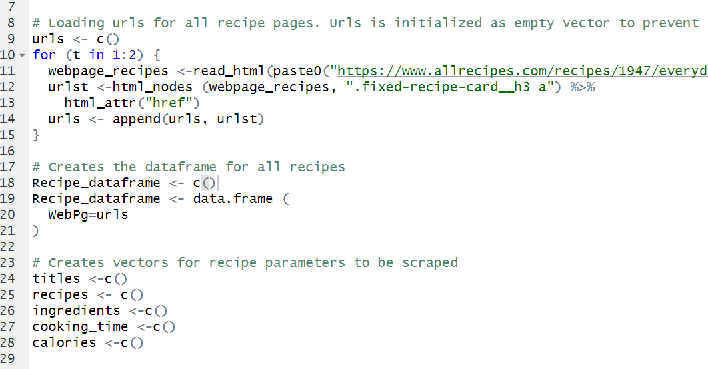
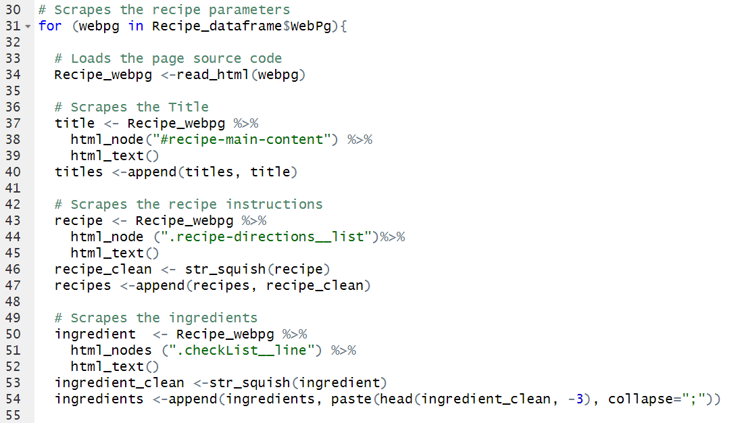
Web scraping

Slide 5
Extracting ingredients
To filter and classify each recipe, we used the function grep() which allowed us to find the indexes of the recipes that contains our keyword.
Using thoses indexes and a for loop, we constructed a matrix of 5 columns containing the informations related to the ingredient we chose.

Slide 6
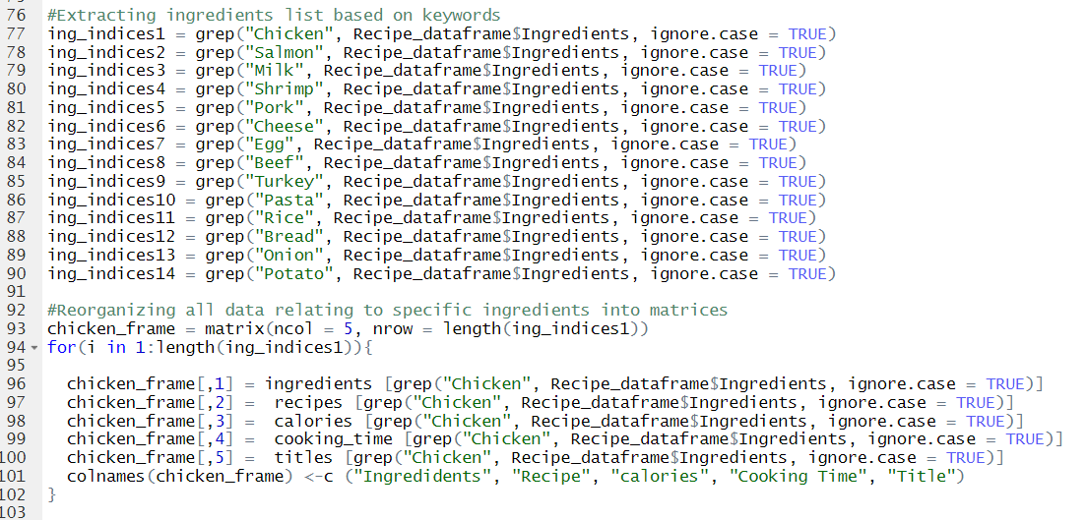
Extracting ingredients

Slide 7
Creating the application
We chose to use a sidebarPanel with checkboxes to allow the user to select the ingredients.
Then we put conditionalPanels connected to the selection of the ingredients. Those conditionalPanles are selectInput. We found that it was the best way to show the recipes.
In the mainPanel, we displayed the recipe, the ingredients, the calories and the cooking time using verbatimTextoutput().

Slide 8
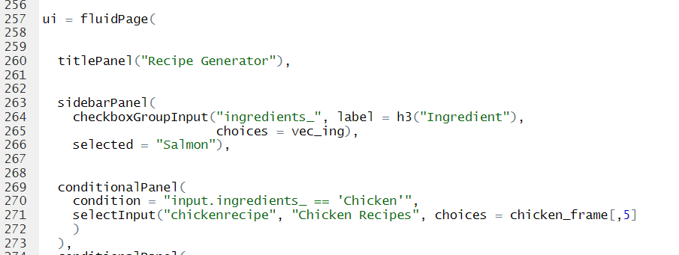
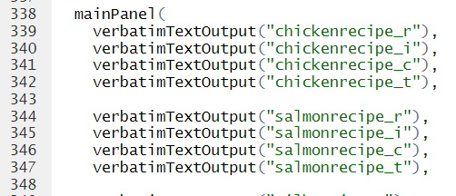
Creating the application

Slide 9
Creating the application
Finally, in the server function we used renderPrint to diplay the text.
In order to show the right recipe related to the box selected, we used the function match(). It definitely made our life easier by allowing to use the value returned by the match() function to display the different parts of the recipe.

Slide 10
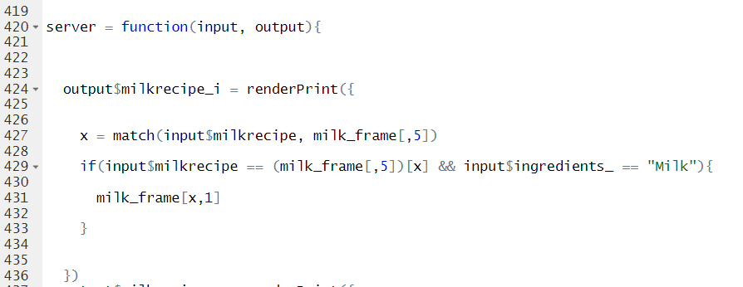
Creating the application

